Slide 1
What is randomization and how does it solve the causality problem?
Module 2.3

Slide 2
Randomization and causation
Participants and nonparticipants are chosen at random
There is no reason, other than chance, that they are selected into the program
On average, participants and nonparticipants have the same characteristics
  they would, on average, have the same outcomes
Any difference at the end is due to the program (or chance, to which we will return)

Slide 3

Randomization creates groups with similar characteristics
Treatment
group 1
Treatment
group 2
Study sample
Comparison group

Slide 4
Random assignment vs. random sampling
Random assignment
  Units (people, schools etc.) are randomly assigned to different groups (e.g. treatment and comparison)
  Creates two or more comparable groups
  Basis of randomized evaluation
Random sampling
  Want to measure the characteristics of a group (e.g. average height)
  Measure a random sample of the group
  Often used during randomized evaluations, especially group level randomization

Slide 5
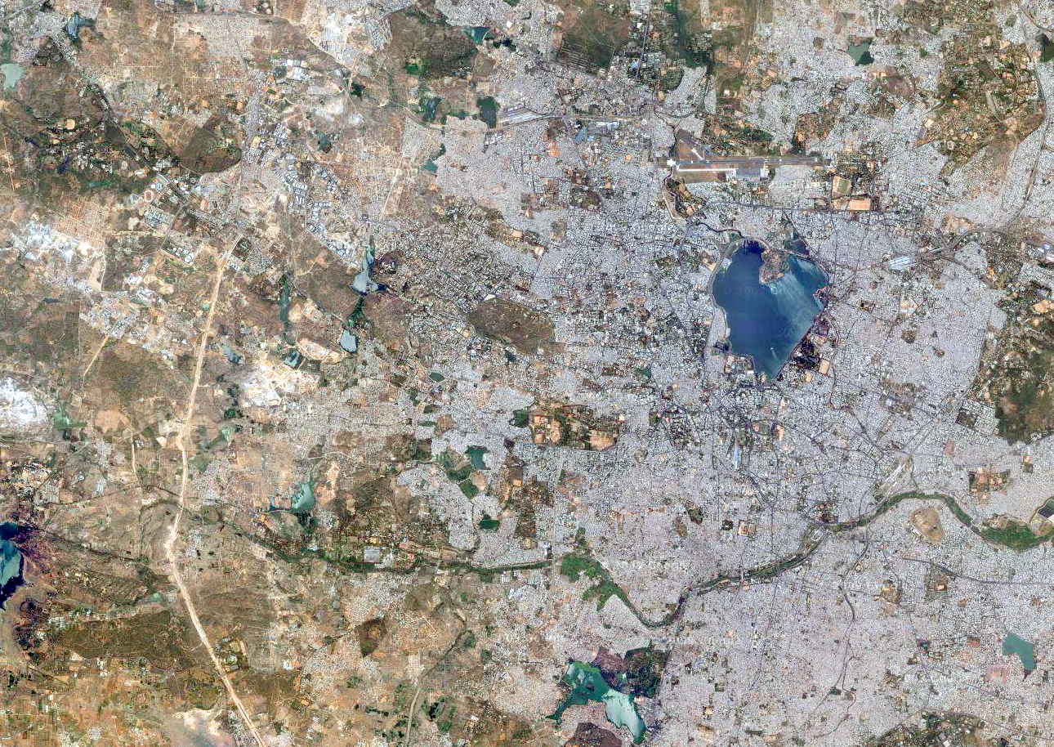
Random sampling
Randomly sample
from area to get study sample
Notes:
So this is what you’ll cover in the WHY Randomize lecture tomorrow afternoon.
First, what is the difference between Random Sampling and Random Assignment

Slide 6
Random sampling and Random Assignment
Randomly sample
from area to get study area
Randomly assign
Communities to treatment
and comparison
Randomly sample
Individuals to survey from both treatment and comparison

Slide 7
Steps in random assignment
Define those eligible for a program
Randomly assign which units are in the treatment and the comparison group
Implement the policy or program for the treatment group
Compare outcomes for those in treatment and comparison groups

Slide 8
Steps to randomization: 1

Slide 9
Steps to randomization: 2

Slide 10
Steps to randomization: 3

Slide 11
Steps to randomization: 4

