Slide 1
Asking the right questions
Chapter 3

Slide 2
Nonimpact evaluations and when they are most useful
Module 3.1

Slide 3
Different forms of assessment
Strategic review: what should our objective be?
Needs assessment: understanding the problem, current solutions
Process evaluation: was the program or policy carried out as planned
Business case assessment: could the program work under different scenarios?
Literature review: what have others found works?
Impact evaluation: how did the program or policy change peoples lives

Slide 4
Needs assessment
What is involved?
Generating a description of the problem and existing solutions using interviews and focus groups, existing data, or new surveys
Examples of questions that can be answered:
What is the level of learning, who is falling behind?
Who do people currently borrow from, at what interest rates?
What is the absenteeism rate of clinic staff?

Slide 5
When a needs assessment is sufficient
Focuses attention on a neglected problem
Good description of the challenges on the ground can help redirect energies from issues that are less of a problem to those that are major
The problem is not what we thought
Example: in designing a program to provide sanitary pads to help girls stay in school we find
they do not skip school more during menstruation
Biggest reason for missing school is teacher absence
Main complaint about menstruation is period pains
The conditions for a successful program do not exist
Example: in designing a health worker training program we find absence rates are very high. We decide to concentrate on absenteeism before increasing training

Slide 6
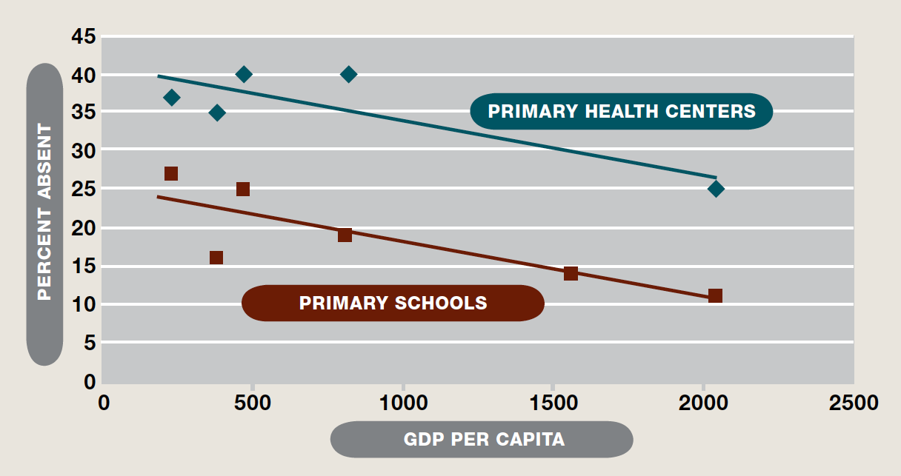
Example: levels of provider absenteeism
Absence Rates
India
Indonesia
Uganda
Bangladesh
Uganda
India
Peru
Indonesia
Ecuador
Bangladesh
Peru
Source: Chaudhury et. al, 2006.
6
Notes:
http://www.povertyactionlab.org/
6

Slide 7
Needs assessments for RCTs
A needs assessment is not always sufficient but it is usually necessary, including as first step in an RCT
Needs assessment helps us:
Determine the right target for the intervention (what geographic location, what age range, what income group)
Improve the design of the intervention

Slide 8
Process evaluation
What does it involve?
Tracking implementation of each step of theory of change using paper trail and field checks
Tracking finances
All projects need process evaluations
When is a process evaluation sufficient?
When implementation is very poor little point in evaluating impact
When impact has been evaluated in enough other situations, good implementation should translate into impact

Slide 9
Example: decentralization in Sierra Leone
In 2005 Sierra Leone created new Local Councils and decentralized supervision over many services
The decentralization secretariat and World Bank carried out a process evaluation asking:
How much of funding got devolved?
Did services improve post decentralization? (not causal)
Did local staff view who they reported to as having changed?
Did local councilors and district officials make supervisory visits?

Slide 10
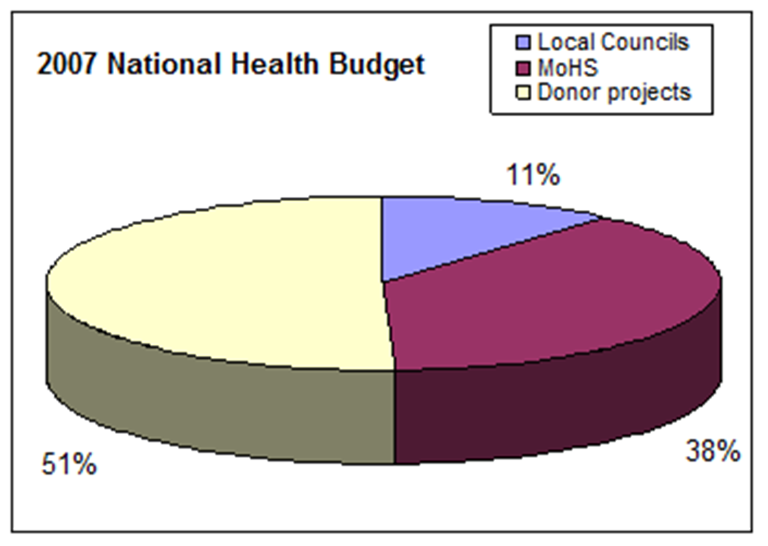
Local council control over health spending
Local councils controlled only a small fraction of health spending even after decentralization
Source: Casey in Zhou, 2009

Slide 11
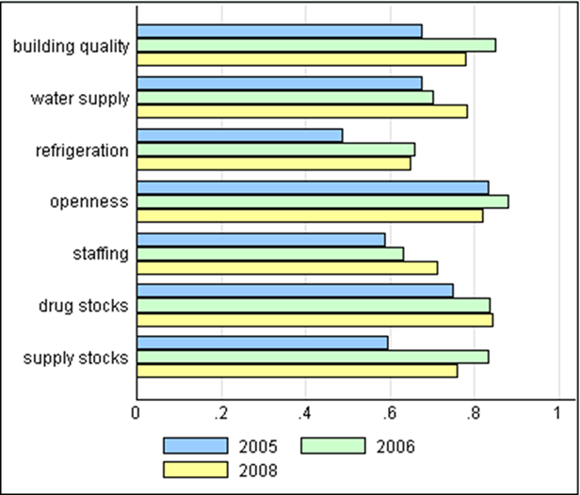
Clinic indicators pre and post decentralization
Source: Decentralization Secretariat, 2009

Slide 12
Supervision and decentralization
District health officers supervising more
Local councilors not supervising well
Source: Decentralization Secretariat, 2009

Slide 13
Literature review
What is it?
Summary of results from related descriptive studies, process, and impact evaluations
Methodology
Clear description of scope
Process for finding all relevant work
Quality standard for inclusion in review, comments on quality of those studies included
Draw common lessons across studies
When is it sufficient?
Evidence from other studies suggests clear way forward

Slide 14
Cost-effectiveness or business case assessment
What does it involve?
Examine likely path to impact, what are realistic or best case outcomes. How do those compare to costs?
Compare projected cost-effectiveness with alternatives
Works best when there have been high quality impact evaluations of different alternatives
When is it sufficient?
When even under best case scenario, current project would not be more cost-effective than alternatives
Sometimes dividing total cost by number of beneficiaries can be very informative

