Slide 1
The Practicalities of Running Randomized Trials: Lecture 2: When to randomize and when not to
Rachel Glennerster

Slide 2
Outline
Why randomize (quick review)
Pros and cons of alternative approaches (quick review)
Advantages and limitations of RCTs
What makes a good question for an RCT?

Slide 3
The problem of causality (quick review)
Much of statistics is designed to address sampling uncertainty, causal inference designed to address uncertainty about potential outcomes
Counterfactual: what would have happened if…
Only observe one outcome for an individual (ie don’t observe counterfactual).
Look for a group of people that on average are the same as participants would have been without the program
Different causal estimation techniques propose alternative comparators
Time series/event study, counterfactual is individual pretreatment
Selection bias is when counterfactual group different in ways other than treatment status
Deaton already thinks we have taken a wrong turn—what is it?

Slide 4
Qualitative
Description and assessment not boiled down into numbers
Advantages
More detail and nuance than quantitative evaluations
Questions are open ended, flexibility to respond to pathways of impact not anticipated prior to study start
Can generate new hypotheses of impact pathways
Assumptions required for assessing impact
Respondent or researcher knows the counterfactual, eg by comparing with life prior to program or to nonparticipants and reveal it truthfully
More research judgment in aggregating or highlighting responses. Need stronger assumptions about no researcher bias. Are nonrepresentative but interesting individuals given more weight?

Slide 5
Pre vs. post comparisons
Comparison of outcomes before and after the start of the program
Who is the comparison group?
Participants prior to the start of the program
Advantages
Relatively simple
Assumptions required
No changes in the environment or individuals over time not related to the program
Participants did not sign up because of a shock, eg they just lost their job

Slide 6
Cross section comparisons
Comparisons across individuals at the same time
Who makes up the comparison group?
Nonparticipants
Advantages
Can be undertaken after the program has started
Required assumption
Participants are not different from nonparticipants in any way except as a result of the program, including in the potential for future change

Slide 7
Multivariate regression
Comparison between participants and nonparticipants in which observable differences are controlled for
Who makes up the comparison group?
Nonparticipants with the same measured outcomes at program start
Advantages
Adjusts for some of the differences between participants and nonparticipants
Required assumption
The only differences between participants and nonparticipants are those we have data on

Slide 8
Multivariate regression: matching
A form of multivariate regression where participants are placed in categories and “matched” with nonparticipants with the same characteristics
Who makes up the comparison group?
Option 1: nonparticipants who have the option to take up the program but dont take up and have the same observable characteristics
Option 2: nonparticipants that did not have the chance to take up and have similar attributes to those who take up

Slide 9
Matching example
$
Poor woman
$
$
Poor man
$
$
Rich woman
$
$
$
Rich man
$
$
Takes up program
District 1: program offered
District 2: no program
Not everyone takes up the program

Slide 10
Matching: option 1
$
Poor woman
$
$
Poor man
$
$
Rich woman
$
$
$
Rich man
$
$
Takes up program
District 1: program offered
District 2: no program
Comparison group: those with similar characteristics who don’t take up
Q: why might those who don’t take up be different?

Slide 11
Matching: option 2
$
Poor woman
$
$
Poor man
$
$
Rich woman
$
$
$
Rich man
$
$
Takes up program
District 1: program offered
District 2: no program
Compare those who take up the program with those with similar characteristics who don’t have access to the program
Q: what might be different between poor woman in district 1 vs district 2?

Slide 12
Multivariate regression: matching
Advantages
Many consider matching worse than standard multivariate regression as the assumptions are less transparent
Required assumptions
Option 1: the only reason one person took up and a matched individual didn’t is chance
Option 2: any difference between the areas where the program is and is not operating is the difference in the number of people with given characteristics
E.g. the poor in program areas are the same as the poor in nonprogram areas

Slide 13
Difference-in-difference
Compares changes over time between participants and nonparticipants
Who makes up the comparison group?
Nonparticipants, but we compare changes (rather than levels) for participants and nonparticipants
Advantages
The approach takes into account general changes over time that are common to both participants and non participants
We do not need to assume that we have measured all differences between participants and nonparticipants
Required assumption
The only differences between participants and nonparticipants are in the levels of observed and unobserved outcomes at the start
There is no difference in the potential for change, or starting growth rates between participants and nonparticipants

Slide 14
Regression discontinuity
Comparison between those who are just eligible and just ineligible to participate in a program
Who makes up the comparison group?
Those who just miss an eligibility cut off
Advantages
Participation is determined by a rule (not self section)
We can adjust for those characteristics we know determine participation
Those just above and below the cut off will be very similar even on these characteristics
Required assumptions
The program eligibility is administered exactly according to the rules
Measurement of criteria used in the cut off is not manipulated to get some people into the program
There is nothing else that suddenly changes just at the cut off point
There are a large number of people just above and below the cut off

Slide 15
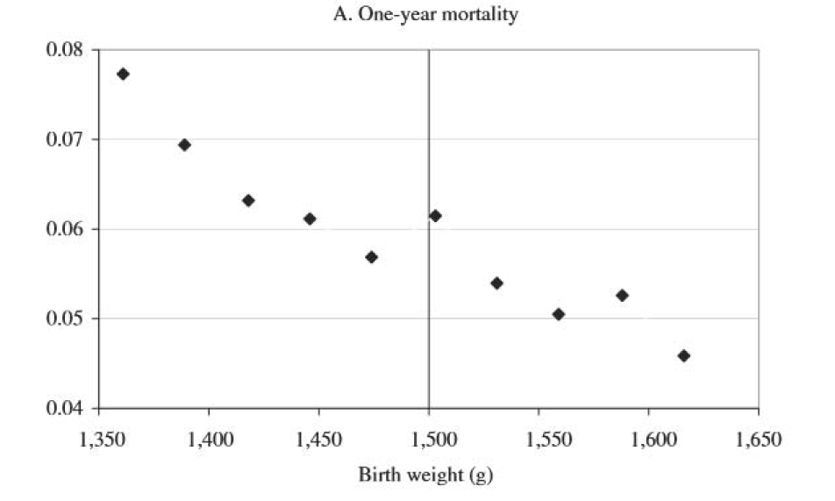
RDD: Value of intensive care
Children born with low birth weight in the US are put into intensive care
Intensive care is expensive, but how much does it help low birth weight children?
Many doctors use a weight cutoff of 1,500 grams to determine if a child needs intensive care
Risk of dying declines as weight goes up but those just above and below the cutoff should be similar
Except that those below get intensive care
Almond et al (2010) use this to estimate the benefit of intensive care
Better or worse than an RCT?
Source: Almond, Doyle, Kowalski, and Williams, 2010.

Slide 16
Instrumental variables
Uses a random variable (the instrument) to predict program take up
Who makes up the comparison group?
Those predicted not to take up by the instrument
Advantages
The right instrument can deal with selection bias
Required assumptions
The instrument predicts take up
The instrument does not predict anything else that could effect outcomes, i.e. there is no selection in the instrument, and the instrument impacts take up but nothing else relevant to the outcome

Slide 17
Example: instrumental variables
What is the impact of access to TV on social capital?
TV reception in villages along a valley varies by height of mountain ridge separating valley from large town with TV tower
Instrument: height of ridge
Assumptions
Height of ridge is correlated with use of TV
Height of ridge is not correlated with travel time to town
Height or ridge is not correlated with farming conditions in the village, hence income
People who care most about TV don’t move out of the village
Source: Olken, 2009

Slide 18
Random allocation
Comparison between those randomized to receive a program and those randomized not to
Who makes up the comparison group?
Those randomly allocated it
Advantages
Researcher determines allocation, no selection bias (ie no difference on average in large sample)
Few additional assumptions required
Less complex analysis helps transparency of findings
Can be designed to answer precisely the question we want to answer, we choose place and time
Prospective, so we collect exactly what data we want
Disadvantages/Required assumptions
Only answers one question: one treatment and comparison group creates one difference
Prospective, so have to wait for outcomes to happen, often only have the data we collect (forget something and you cant just merge with another dataset)

Slide 19
When a randomized evaluation is not useful
When outcomes can only be measured at a very high level
Fixed vs. floating exchange rates
Freedom of the press
When the result can be found faster exploiting existing data and a quirk that generates random variation
When general equilibrium effects are important
Outcome (like price) is determined by the aggregate of hundreds or thousands of interactions
If we change some interactions but not others, we can only observe the aggregate effect
Only possible to study when markets are somewhat separate
When the question is not about causality
When there is sufficient causal evidence and its time to act on existing evidence

Slide 20
General vs. specific research
Indonesia family life survey
Survey on education, health, assets. Representative of 83% of Indonesia, 4 waves since every 1993
Use to assess shocks or programs where happens to be some quasi randomness in implementation
Used for evaluating school building program, (Duflo, 2000)
Community monitoring evaluation in Indonesia
Communities randomized to receive either more external or more local monitoring of road projects
Know from start we can compare these two approaches to monitoring
Collect exactly the data needed to monitor corruption by digging up random sample of road and weigh materials used

Slide 21
Asking the right question in an RCT

Slide 22
Prioritizing among different RCT research questions
How important will a result be (whatever the result is). What will the world do differently as a result?
How much existing evidence is there?
How many people does the policy impact, or could impact? (scale * tractability)
Is it an innovation that could be scaled (cheap, easy to implement)
Does it provide insight on an issue of general interest, ie explains how/why humans/firms behave
Is the question tied to one context, or more generally applicable (in practice or theory)
Can the question be answered well?
Good way to measure outcomes
Sufficient sample size to be able to pick up a reasonable effect (more on this later)
Good partner?
Is the program/policy, implementer and context representative?
When is representative good, when is it bad?

Slide 23
How much would an RCT cost?
Rigorous impact evaluations vary enormously in cost, important to balance cost and benefits
What makes an evaluation expensive?
Collecting new data vs using administrative data
Randomizing by group (rather than individual)
Rural and remote locations drive up transport costs
When skilled labor is expensive (much of Africa)
Multiyear evaluations
Many treatment arms
Nonsurvey outcomes (like biological tests)
Large expensive evaluations can still be cost-effective by improving the effectiveness of spending but harder to raise funding

